Slide 1
CS 6359 UTD Search Engine

Slide 2
Team Members
Veera Venkata Sairam Dasari (Rest API, React UI & Use Case Diagram)
Srividhya Ranganathan (Rest API, React UI, Use Case Diagram & State Transition)
Krishna Aishwarya (Refiner Engine, Sequence Diagrams & Activity Diagram)
Nikhila Remala (Refiner Engine & Sequence Diagrams)
Shreeya Thatipalli (Refiner Engine & Sequence Diagrams)
Nikhilesh Amarnath (Crawler, Processor, Class Diagram & State Transition)
Ramnath Subramanian (Crawler, Processor & Class Diagram)
Sukumar Varma (Crawler, Processor & Class Diagram)

Slide 3
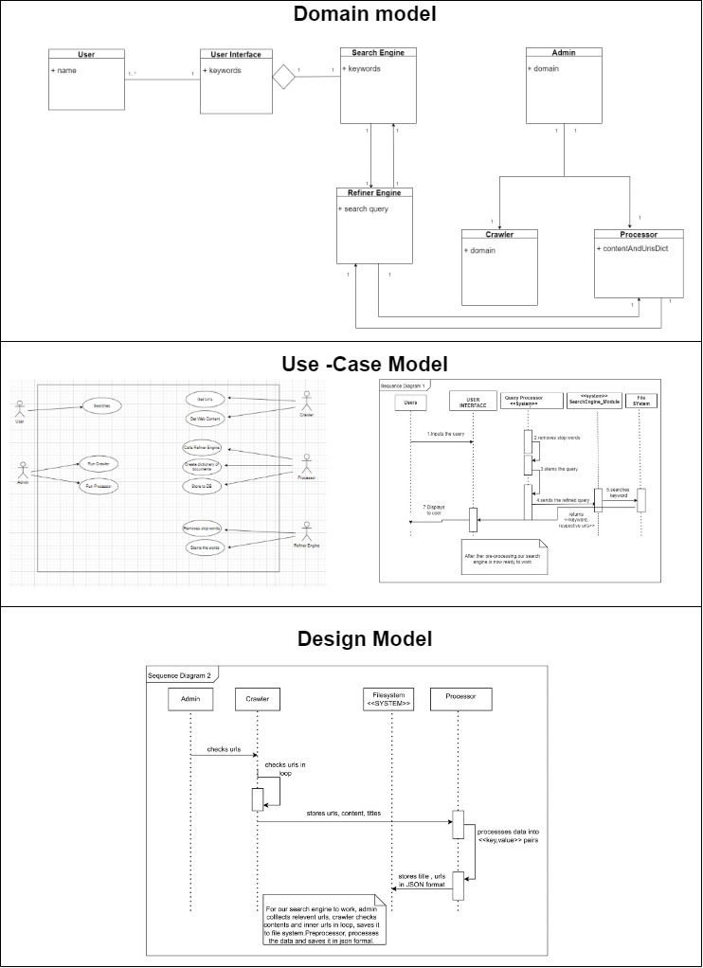
Big Picture

Slide 4
Introduction
Search Engine is a web search engine where user can search for any keyword and get the results.
Based on the keyword entered by the users, the search engine displays the relevant results. The results include the URLs which will redirect to the appropriate webpage.
A small description of the webpage will also be shown below the URL, which will help users to determine the right URL.
The URLs to be displayed will be ranked and will be shown in the ranked order, and the results will be displayed in multiple pages using pagination functionality.

Slide 5
Tools Used
Flask (Micro Web Framework) – REST API
Beautiful Soup (HTML/XML Parser) – Web Scraping
NLTK (Natural Language Toolkit) – Word Stemming and stop words removal
React (Front-end Javascript Library) – Front-end UI

Slide 6
Functional Requirements
Search Functionality: When the user searches for a keyword, the result will be fetched from the database and displayed to the user. The results must be accurate and quick. Users will be shown the URL and a short description about the webpage.
Ranking: The order in which the results will be shown is determined by the TF-IDF scores of the words searched in the displayed URL. The most relevant URLs will be shown first. This will help users to find the results quickly. This will be implemented in phase 2.

Slide 7
Functional Requirements
Auto-suggestion: When user starts typing in the search box, the user will be suggested a with a set of words based on the input characters. For example, if user types ‘ins’, then the user will be suggested with words like instructors, instate tuition etc.
Filtering: Generic words should be eliminated from the user input. Only the keywords should be considered for the search. For example: ‘The Professors’, in this input query, ‘The’ should be eliminated and only the ‘Professors’ should be considered as the keyword.
No results found: When user enters an unknown keyword for the search engine, the search engine displays an empty results page

Slide 8
Non-Functional Requirements
Friendly User Interface: Interface will be easier for the users to understand and navigate which includes features like, pagination, suggesting relevant search results and adding more options such as support for multiple keyword search and ignoring spelling mistakes.
Reliability and Speed: Search results should be more accurate and should be returned quickly. Code must be optimized accordingly.
Extensive Search: More URLs must be added to the database by using Crawler, so that users will have access to more search results.
User Experience: Users should be able to access the search functionality from any page. A short should be given below every link to give users a small glimpse of the webpage.

Slide 9
Crawler
Crawls a particular domain
Scrapes webpage content and URLs
Recursively accesses the next URL and scrapes more content & URLs
Ignores webpages under robots.txt

Slide 10
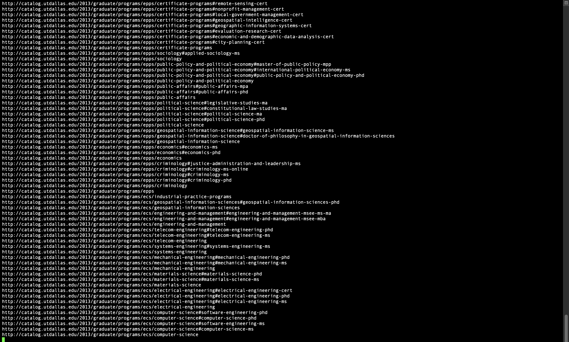
Crawler

Slide 11
Processor
Takes Crawler raw output as input
Removes stop words from the web page content
Stems the words to the root form
Maps the URLs to the word along with frequency
Stores the final map to JSON

Slide 12
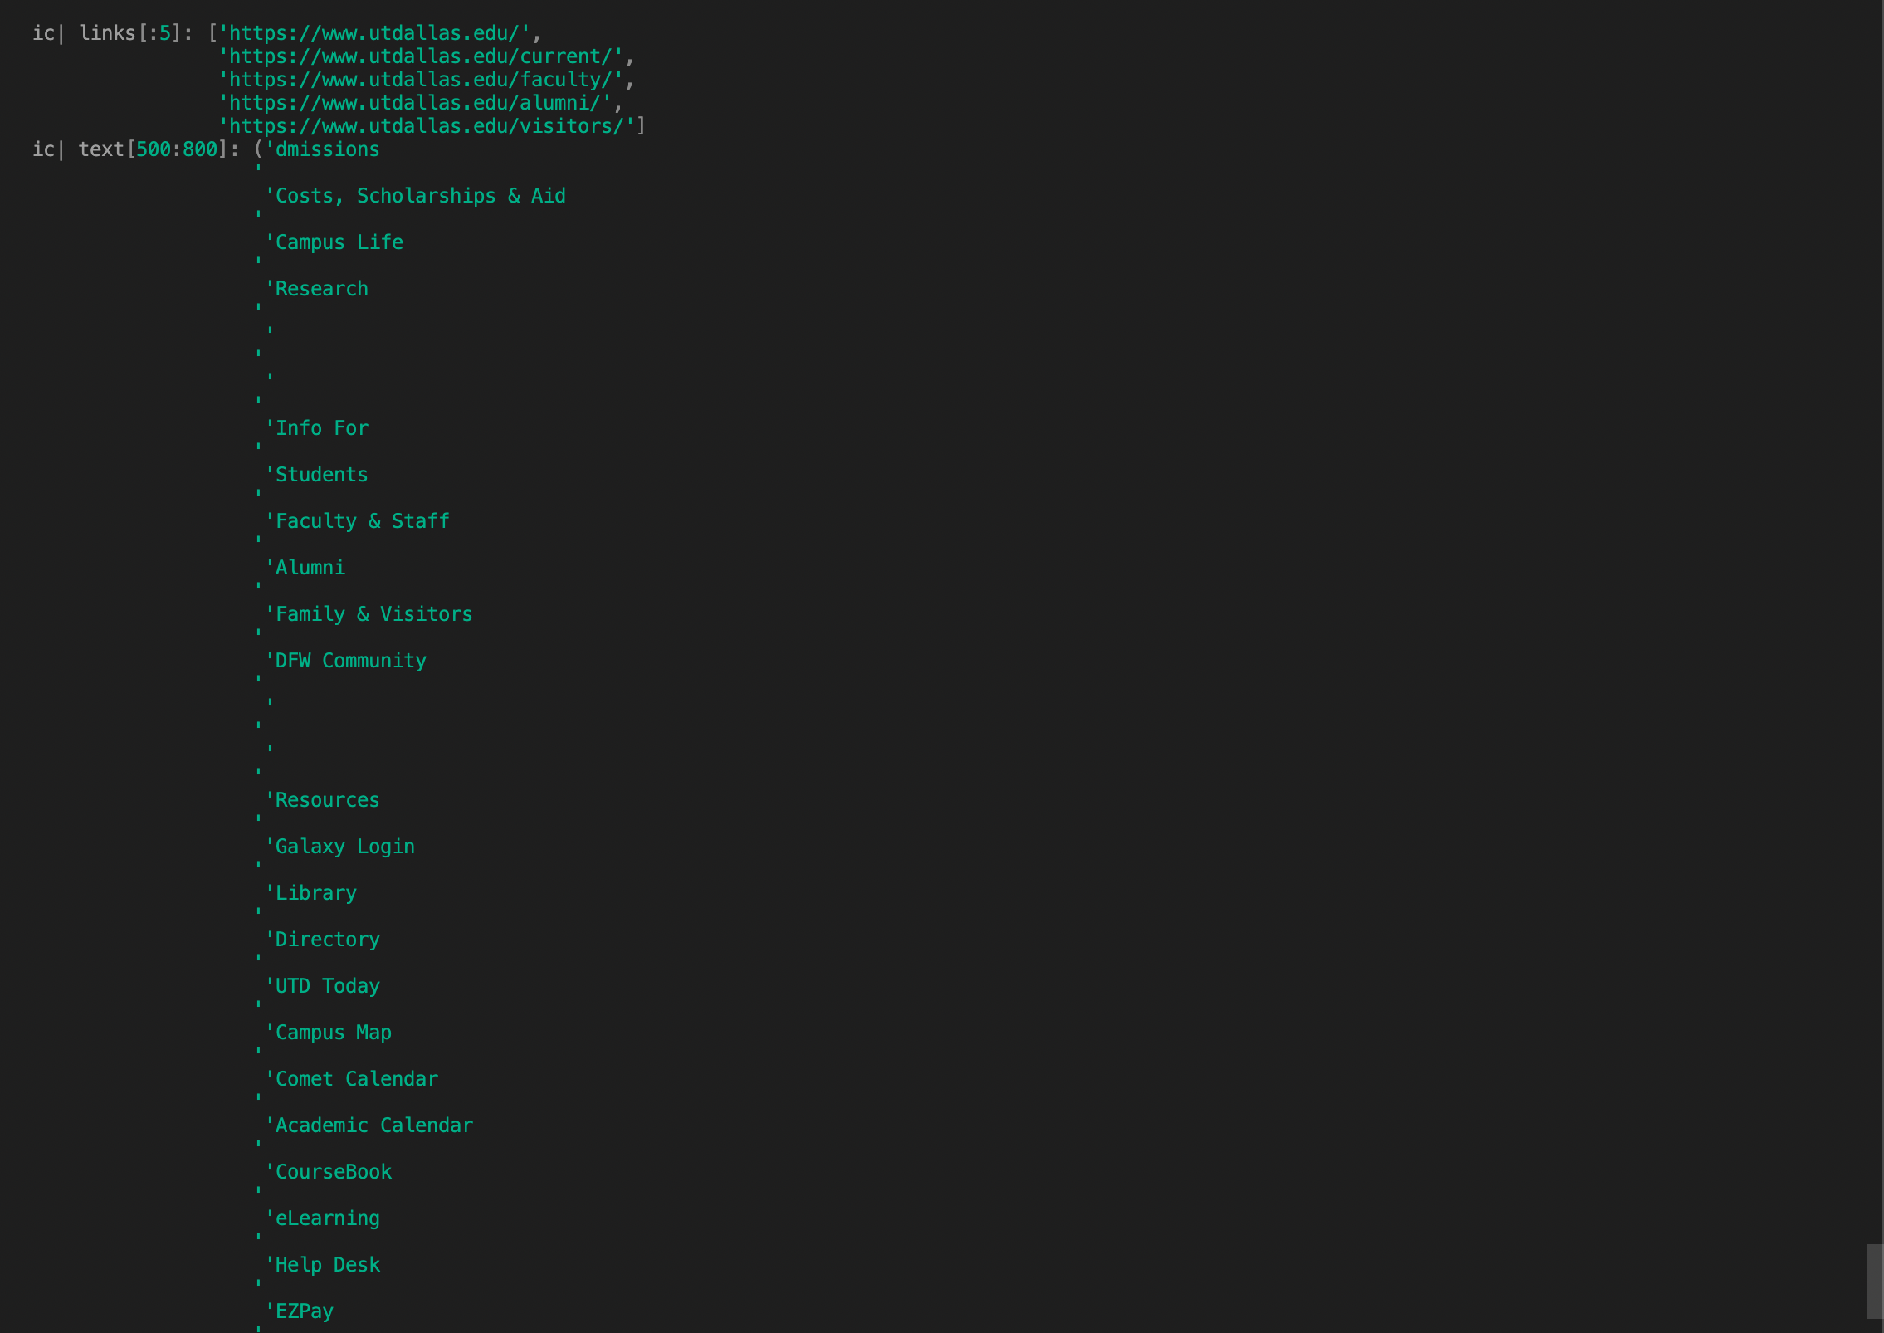
Processor – Input

Slide 13
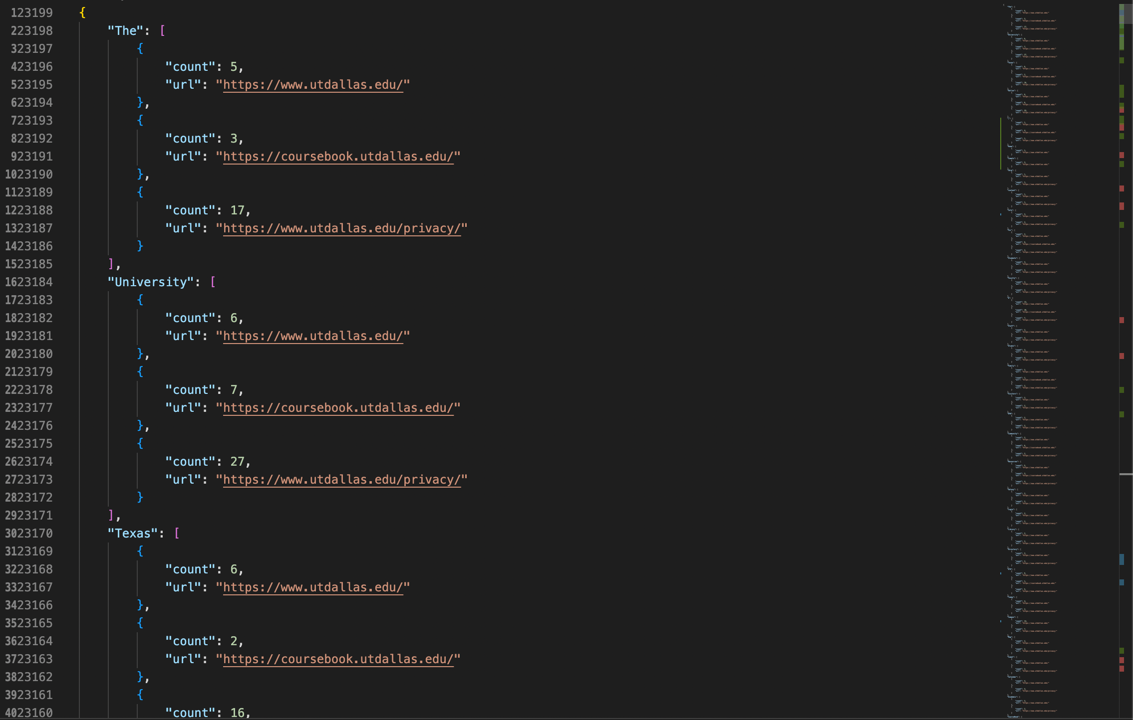
Processor - Output

Slide 14
UML Diagrams
Use Case Diagram
Activity Diagram
State Transition Diagram
Sequence Diagram
Class Diagram

Slide 15
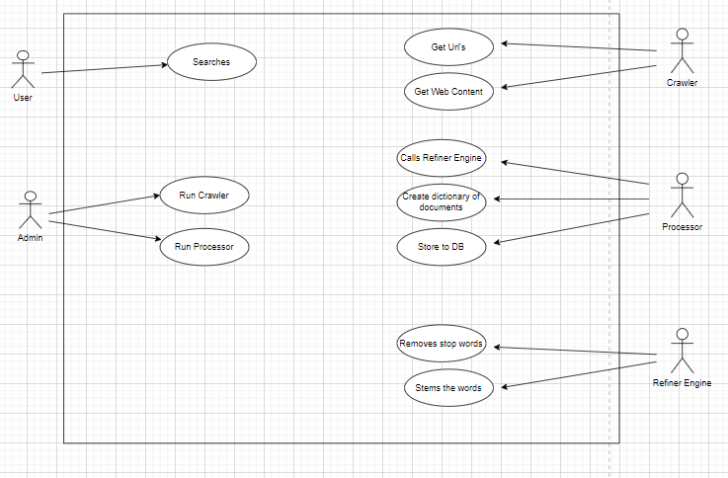
Use Case Diagram

Slide 16
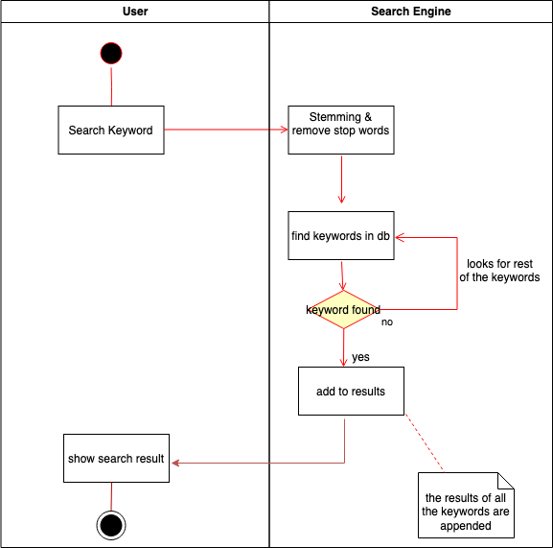
Activity Diagram

Slide 17
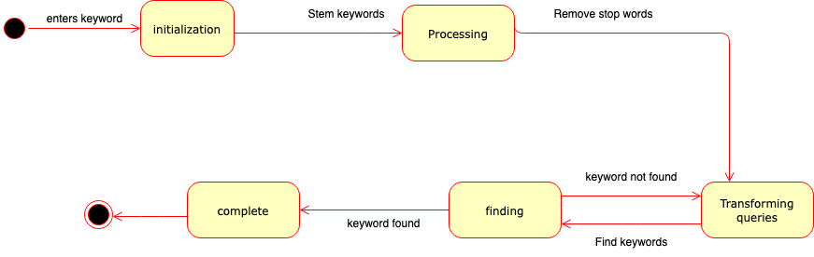
State Transition Diagram

Slide 18
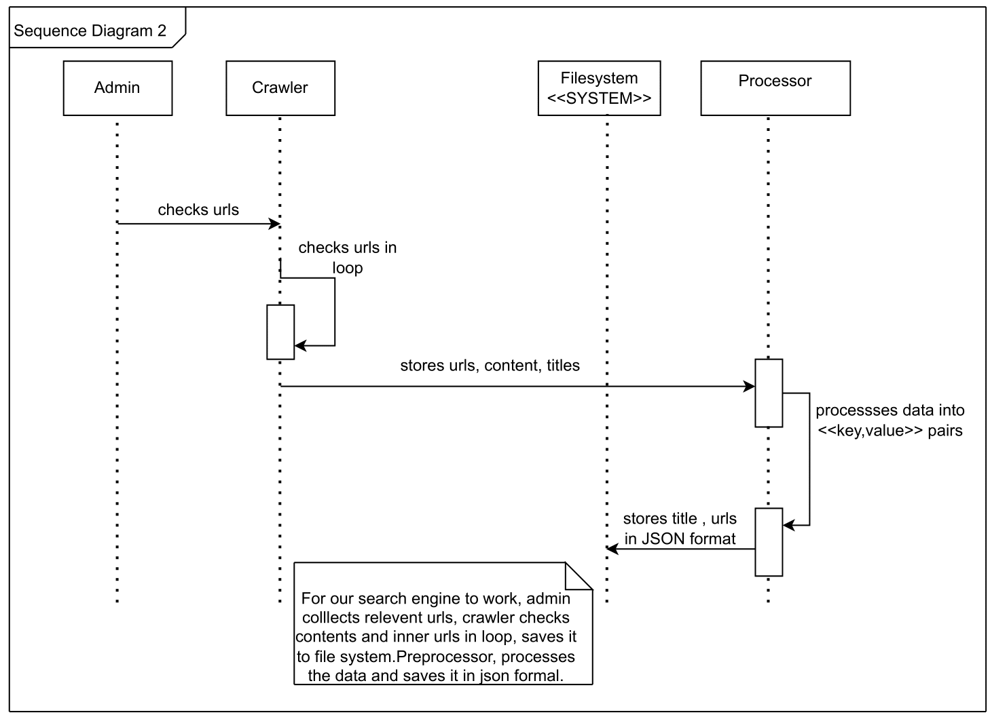
Sequence Diagram – Crawler/Processor

Slide 19
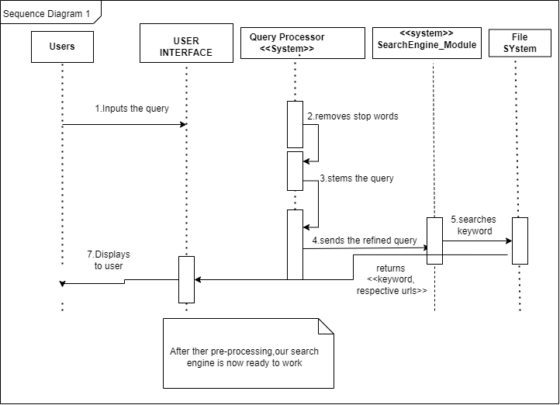
Sequence Diagram – User

Slide 20
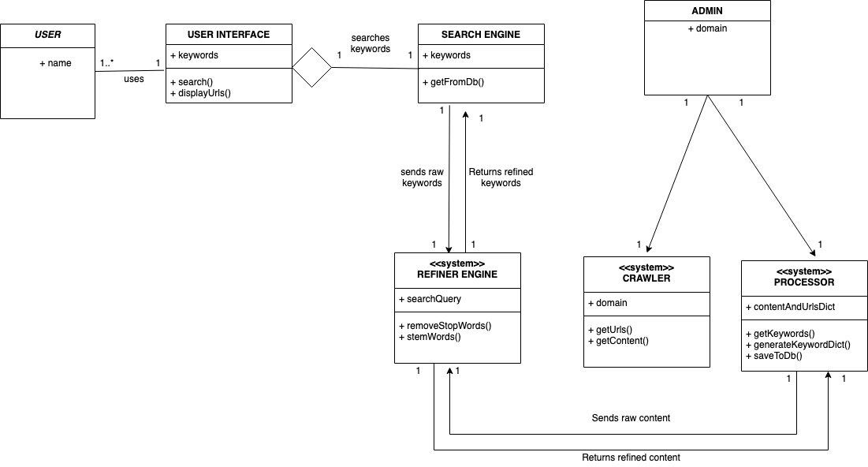
Class Diagram

Slide 21
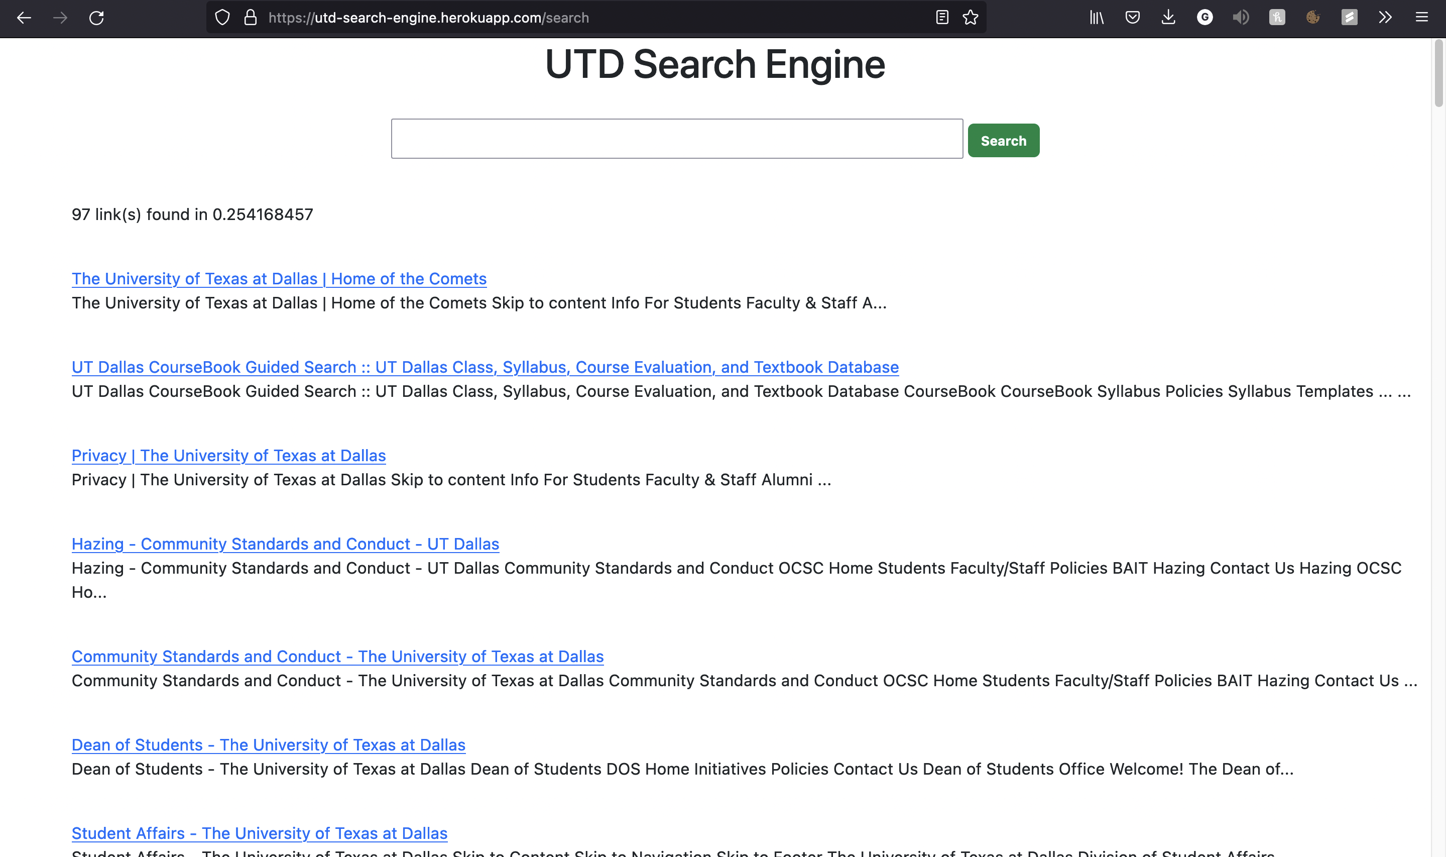
Web Page

Slide 22
Thank You

